Slide 1
College of Agriculture and Life Sciences
Department of Horticulture Sciences
Plant Breeding Consortium
CS/HS 541 Plant Breeding Methods
Simulations
Roberto Fritsche-Neto
Assistant Professor - Vegetable Molecular Breeding
2025

Slide 2
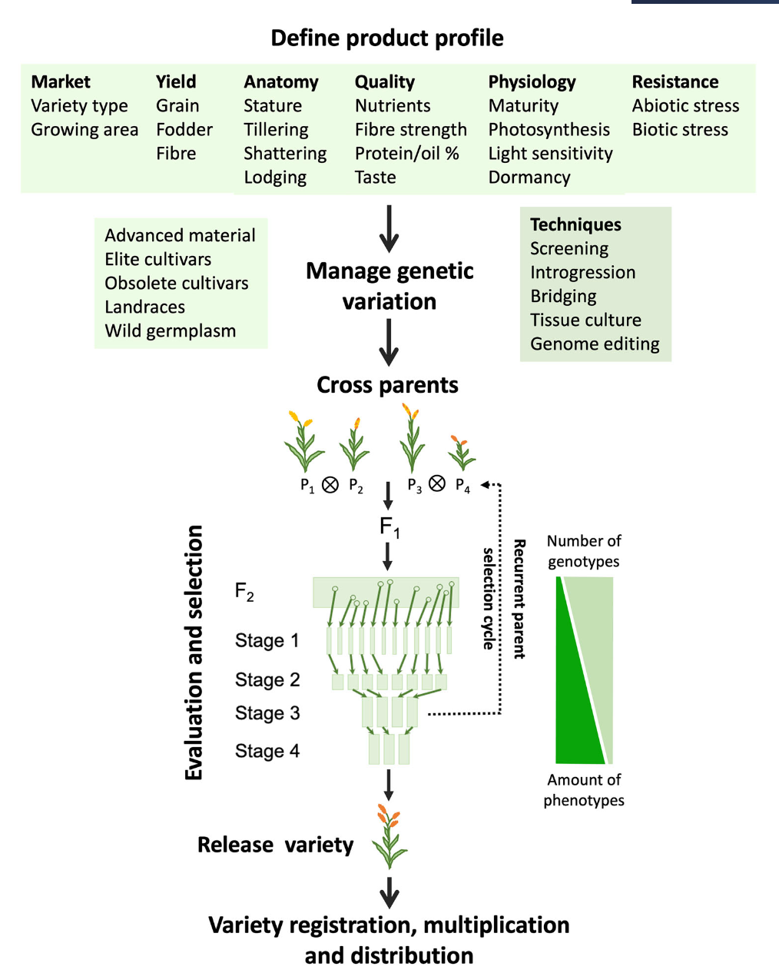
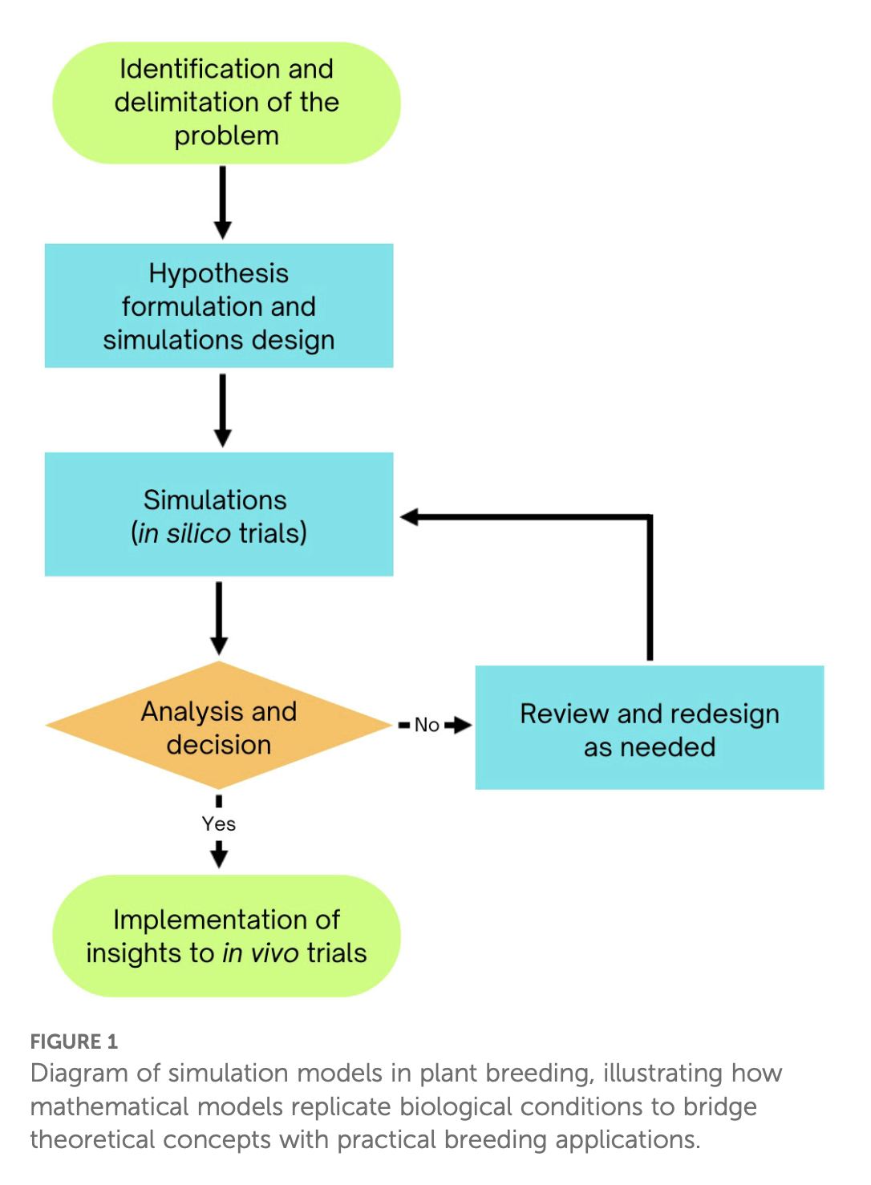
Overview
Main steps
Outlining the breeding program
Specifying global parameters
Simulating genomes and founders
Filling the breeding pipeline
Running the burn-in phase
Running the future phase with competing scenarios
Replication and examining the results
DOI: 10.1002/csc2.21312
https://doi.org/10.3389/fpls.2025.1495662

